Slide 1
What is a front-end development?
Front-end development primarily focuses on user experience .
Using the related coding and design techniques,you as front-end
developers build the elements of an application that are directly accessed by end-users with a goal of rendering the intire interface
elegant,easy to use,fast ,and secure,fostering user engagement and interaction.
Front-end developers require a specific set of skills to effectively
create user interfaces.This includes proficiency in coding languages like HTML,CSS ,and JavaScript ,as well as a strong understanding of CSS preprocessors such as Sass and Less.
Front-end development primarily focuses on user experience. Using the related coding and design techniques,
you as front-end developers build the elements of an application that are directly accessed by end-users with a
goal of rendering the entire interface elegant, easy to use, fast, and secure, fostering user engagement and interaction.
As part of creating an engaging user interface, front end app development often focus on specific design
elements such as text colors and styles, images, graphs and tables, buttons, and overall color schemes.
These elements play a crucial role in enhancing the visual appeal and user-friendliness of the application.
Front end app development encompasses various interactive elements like sliders, pop-up forms, and custom
interactive maps. An essential part of a front end application are navigational menus, which guide users
through the application, enhancing their overall experience and interaction with the website or application.
The creation of intuitive and user-friendly navigational menus is a key skill for front-end developers.
Front-end developers require a specific set of skills to effectively create user interfaces.
This includes proficiency in coding languages like HTML, CSS, and JavaScript, as well as a strong understanding of
CSS preprocessors such as Sass and Less. In terms of career requirements, aspiring front-end developers often
pursue a degree in Computer Science or a related field, although this is not always a mandatory requirement.
A strong foundational understanding and proficiency in coding languages such as HTML, CSS, JavaScript,
and increasingly, jQuery, are essential.
Additionally, an understanding of server-side CSS processing techniques and their applications in web
development is beneficial. In terms of CSS, front-end developers must also be adept at styling text, including
choosing appropriate colors and styles to ensure readability and enhance user engagement. They should also
be skilled in TypeScript, a superset of JavaScript, which adds static typing abilities to the language.

Slide 2
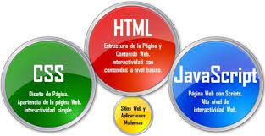
Who is front-end developer?
A front-end developer creates websites and applications using web languages such as HTML, CSS, and JavaScript that allow users to access and interact with the site or app. When you visit a website, the design elements you see were created by a front-end developer.

Slide 3
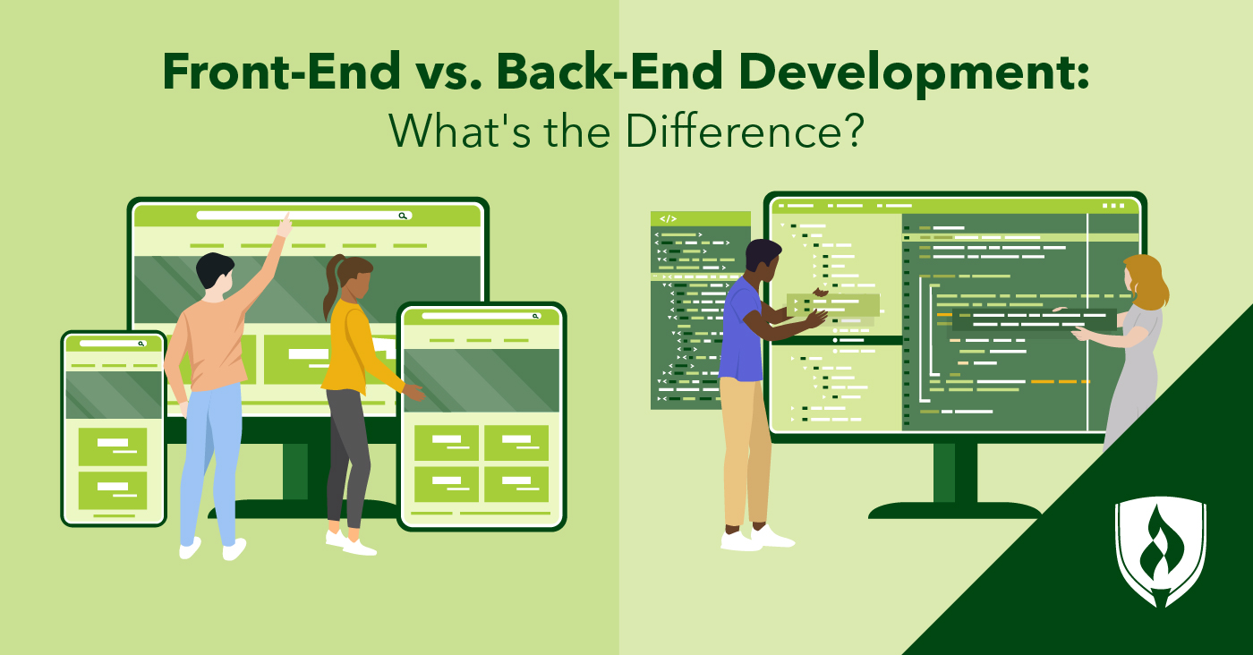
Front-end development explained?
Front-end development is the process of building components that interact with users. Examples are the user interface, buttons, user-entered data, websites, and user experience (UX) features. The front end aims at meeting user requirements and delivering a positive user experience.

Slide 4
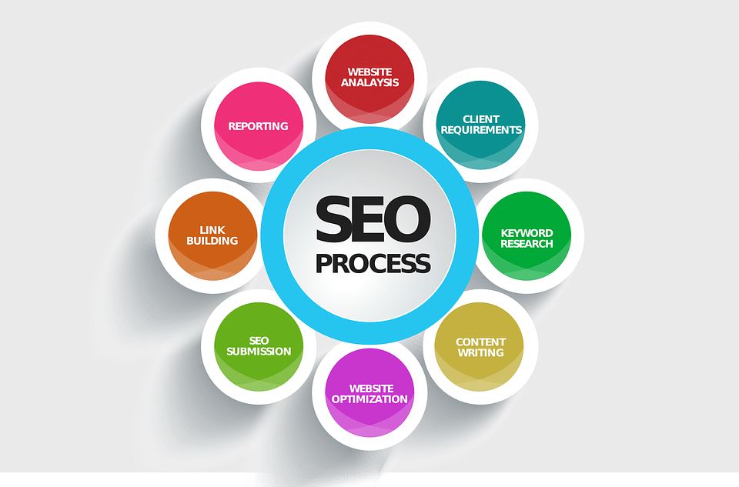
What is SEO in web development?
SEO stands for Search Engine Optimization. In a nutshell, it’s the set of practices that an individual or business uses to get more organic traffic through search engines, like Google or Bing.
As you can tell, the definition is pretty vague. That’s a testament to the fact that SEO can be done in several ways, and has changed dramatically over the last couple of decades. Despite this broad description, all branches of SEO share a common goal: helping you engage with an audience.

Slide 5
Fundamentals of front-end development
Front-end developers typically use three main coding languages to build web applications. HTML, CSS, and JavaScript.
HTML, which is the standard markup language for creating Web pages
CSS stands for Cascading Style Sheets. CSS describes how HTML elements are to be displayed on screen, paper, or in other media. CSS saves a lot of work. It can control the layout of multiple web pages all at once
JavaScript is a scripting language that enables you to create dynamically updating content, control multimedia, animate images, and pretty much everything else.

Slide 6
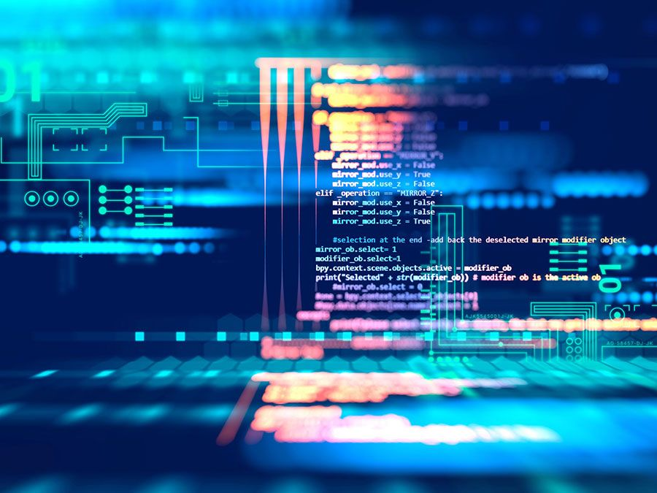
React, which is a JavaScript library for building user interfaces ,single page applications and create reusable UI components
AngularJS, which extends HTML with new attributes
Participants will learn through hands-on practice and will also focus on real-world applications.

Slide 7
What is back-end development?
Back-end development is an aspect of web or mobile app development that is responsible for executing server-side processing to fulfill user requests and enable apps to function. It involves utilizing programming languages to manage data storage, server logic, and the overall architecture of the application.
In comparison to front-end development, which focuses on shaping what the users see, back-end development optimizes the largely unseen server-side components that empower the functioning of the front-end. If an app or website is likened to a car, the back-end components encompass the engine, transmission, and everything else that contributes to making a car run forward or backward.

Slide 8
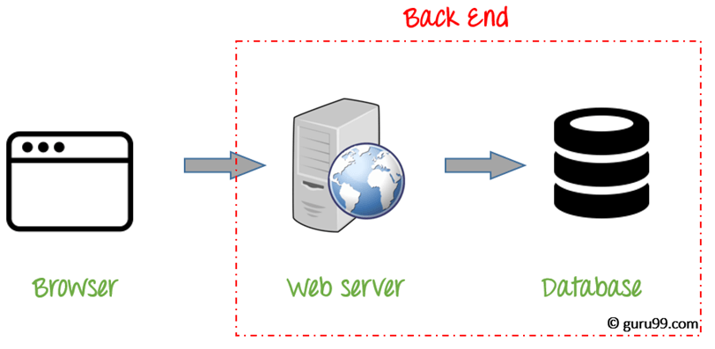
Who is back-end developer?
Backend developers build code that allows a database and an application to communicate with one another. Backend developers take care and maintain the back-end of a website, Including databases, servers, and apps, and they control what you don't see.

Slide 9
Basics of back-end development?
Backend Development is also known as server-side development. It is everything that the users don’t see and contains behind-the-scenes activities that occur when performing any action on a website. It focuses primarily on databases, backend logic, APIs, and Servers.
The backend of a website is a combination of servers, applications, and databases. Code written by backend developers helps browsers in communicating with the databases and store data into the database, read data from the database, update the data and delete the data or information from the database.

Slide 10
Back-end development technologies?
Python
Python is a powerful, versatile, and popular backend language used for web development. It is one of the most popular backend technologies in the list. has a simple syntax which makes it easy to learn and use. Python allows developers to quickly develop applications without having to write complex code. It also supports several frameworks, such as Django, Flask, and Pyramid, that make web development easier.
JavaScript
JavaScript is a versatile, high-level scripting language used in frontend and backend development. It can be used to develop both web and mobile applications. It is cross-platform compatible and can run on multiple platforms with minimal changes. JavaScript also has an active community, making it easy to find tutorials or resources online. Key features include the ability to create dynamic content, access to frameworks like React and Angular, real-time communication support, and integration with HTML and CSS.

Slide 11
Django
Django next on the list of backend technologies. It is a powerful open-source framework written in Python that makes it easy to develop complex websites quickly. It includes multiple features such as a template system for quickly creating HTML pages; an ORM (Object Relational Mapping) framework for database interactions; support for URL routing and middleware applications; out-of-the-box security measures such as password hashing and CSRF protection; and integration with popular databases like MySQL, PostgreSQL, and SQLite.
Node.js
Node.js is a JavaScript runtime environment used to build scalable network applications. It uses an event-driven, non-blocking I/O model that makes it ideal for real-time applications. Node.js has built-in libraries that make web development easy, such as Express.js, which offers robust routing tools, and Mongoose, which provides an easier way to query MongoDB. Other features of Node.js include fast performance; scalability; support for multiple platforms; and integration with popular databases like MySQL, MongoDB, and PostgreSQL.

Slide 12
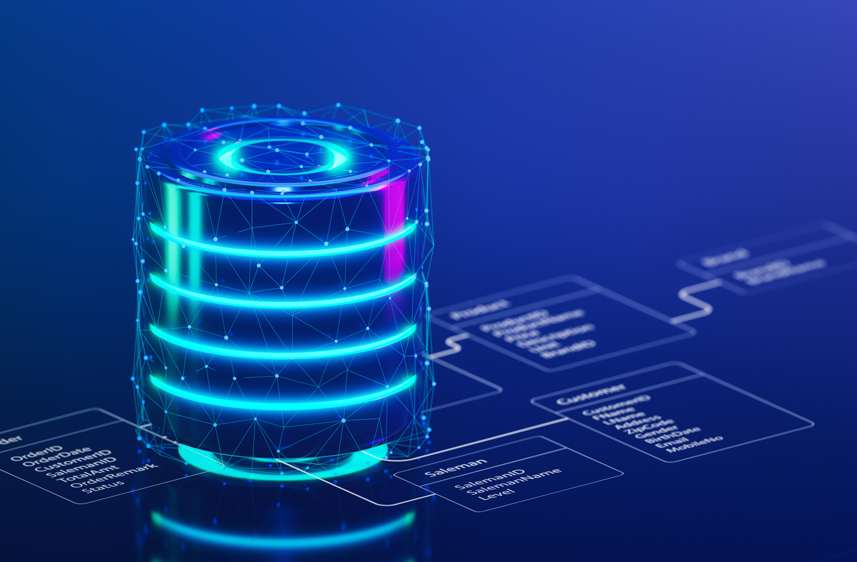
What is database and how it works?
A database is an organized collection of data stored in a computer system and usually controlled by a database management system (DBMS). The data in common databases is modeled in tables, making querying and processing efficient. Structured query language (SQL) is commonly used for data querying and writing.
The Database is an essential part of our life. We encounter several activities that involve our interaction with databases, for example in the bank, in the railway station, in school, in a grocery store, etc. These are the instances where we need to store a large amount of data in one place and fetch these data easily.

Slide 13
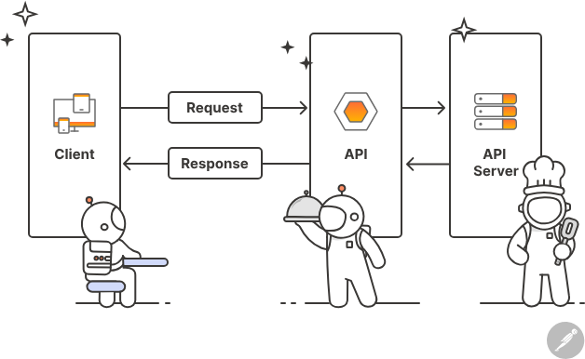
What is API?
An application programming interface (API) is a way for two or more computer programs or components to communicate with each other. It is a type of software interface, offering a service to other pieces of software. A document or standard that describes how to build or use such a connection or interface is called an API specification. A computer system that meets this standard is said to implement or expose an API. The term API may refer either to the specification or to the implementation. Whereas a system's user interface dictates how its end-users interact with the system in question, its API dictates how to write code that takes advantage of that system's capabilities.

Slide 14
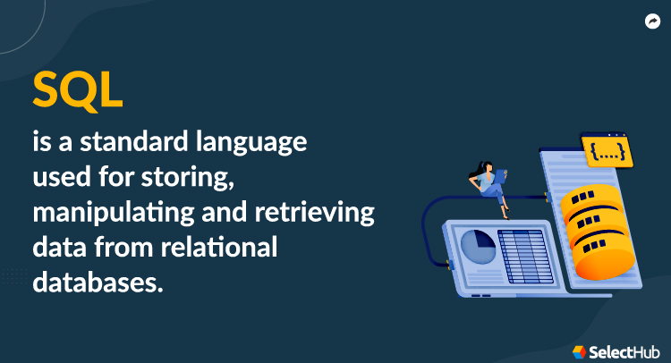
What is SQL
As we discussed in our article about what different programming languages are used for, Structured Query Language, or SQL for short, is a programming language that communicates with databases. The intention of SQL (often pronounced sequel) is to store, retrieve, manage and manipulate data within a database management system.
SQL was developed by IBM in the early 1970s and became commercially available in 1979. It is globally accepted as the standard relational database management system (RDBMS).
It uses sets of keywords to retrieve data from databases, and these keywords are called statements. Later, we’ll take a look at some of the statements available in SQL.

